Slide 1

Veer Surendra Sai University Of Technology, Burla
Submitted To: Dr. DC Rao.
Group members:-
TUSHAR PANIGRAHI : 2102081004
SIMHADRI SANTOSH : 2102081013
SATYAM SIVAM PAL : 2102081021
ASUTOSH PATRO : 2102081024
RAMESH CH. MALLIK : 2203081002

Slide 2
Abstract
Compiler:
A compiler is a software program that compiles program source code files into an executable program.
In simple terms, a compiler is a computer program that changes the language in which programs are written into instructions that a computer can use.

Slide 3
It is included as part of the integrated development environment IDE with most programming software packages.
The compiler takes source code files that are written in a high-level language, such as C, C++, or Java, and compiles the code into a low-level language, such as machine code or assembly code.
This code is created for a specific processor type, such as an Intel Pentium or PowerPC. The program can then be recognized by the processor and run from the operating system.

Slide 4
Phases of a compiler:
The compilation process is a sequence of various phases. Each phase takes input from its previous stage, has its own representation of the source program, and feeds its output to the next phase of the compiler. The phases are:-
Lexical Analysis
Syntax Analysis
Semantic Analysis
Intermediate Code Generation
Code Optimization
Code Generation

Slide 5
Features implemented in this project:
This project contains the implementation of the lexical analyzer phase of the C compiler. In our lexical analyzer we have implemented the following functionalities:-
Data Types: int, char data types with all its sub-types. Syntax : int a=3;
Comments: Single line and multiline comments
Keywords: char, else, for, if, int, long, return, short, signed, struct, unsigned, void, while, main
Identification of valid identifiers used in the language
Looping Constructs: It will support nested for and while loops.

Slide 6
Syntax:-
int i;
for(i=0;i <n;i++) { } int x; while(x<10) { … x++}
6. Conditional Constructs: if...else-if...else statements
7. Operators: ADD(+), MULTIPLY(*), DIVIDE(/), MODULO(%), AND(&), OR(|)
8. Delimiters: SEMICOLON(;), COMMA(,)
9. Structure construct of the language, Syntax: struct pair{ int a; int b};
10. Function construct of the language, Syntax: int func(int x)
11. Support of nested conditional statement
12. Support for a 1-Dimensional array. Syntax : char s[20];

Slide 7
Introduction
Lexical Analysis :
Lexical Analysis is the first process of the compiler.
The input to a lexical analyzer is a high-level language program, such as a ’C’ program in the form of a sequence of characters.
The output is a sequence of tokens, which is passed to the parser for syntax analysis.
The blanks, tabs, newlines, and comments from the source program are removed.
It keeps track of line numbers and associates error messages from various parts of a compiler with line numbers.

Slide 8
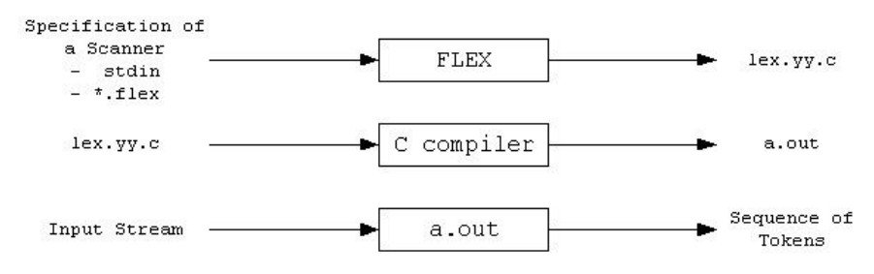
Flex Script
FLEX (Fast LEXical analyzer generator) is a tool for generating scanners. Instead of writing a scanner from scratch, we only need to identify the vocabulary of a particular language (e.g., C language), write a specification of patterns using regular expressions (e.g., DIGIT [0-9]), and FLEX constructs a scanner for us. FLEX workflow depicted as:

Slide 9
First, FLEX reads a specification of a scanner either from an input file *.lex, or from standard input, and it generates as output a C source file lex.yy.c.
Then, lex.yy.c is compiled and linked with the "-lfl" library to produce an executable a.out. Finally, a.out analyzes its input stream and transforms it into a sequence of tokens. The format of the input file contains three sections. These sections are separated by a line with “%%” symbol.

Slide 10
Format of a FLEX Program
Definition section
%%
Rules section
%%
User code section
Definition section: The definition section contains the declaration of variables, regular definitions, manifest constants.
The rules section contains a series of rules in the form: pattern action and pattern must be unintended and action begin on the same line in {} brackets.
This section contains C statements and additional functions. We can also compile these functions separately and load them with the lexical analyzer.

Slide 11
C Program
This section describes the input C program which is fed to the flex script in order to generate the lex file after taking all the rules mentioned in the account.
Finally, a file called lex.yy.c is generated, which when executed recognizes the tokens present in the C program which was given as an input. The script also has an option to take standard input instead of taking input from a file.

Slide 12
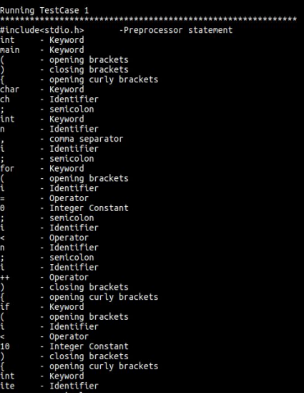
Output :

Slide 13
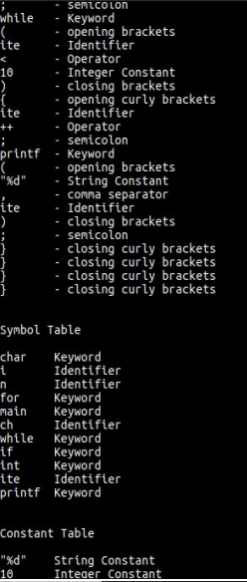

Slide 14
Implementation
The Regular Expressions for most of the features of C are fairly straightforward. However, a few features require a significant amount of thought, such as:
The Regex for Identifiers: The lexer must correctly recognize all valid identifiers in C, including the ones having one or more underscores.
{alpha}({alpha}|{digit}|{und})*
Where:-
alpha [A-Z, a-z]
digit [0-9]
und [ _ ]
space [ ]

Slide 15
Multiline comments should be supported: This has been supported by checking the occurence of ‘/*’ and ‘*/’ in the code. The statements between them has been excluded. Errors for unmatched and nested comments have also been displayed.
Literals: Different regular expressions have been implemented in the code to support all kinds of literals, i.e integers, floats, strings, etc. Float : ({digit}+)\.({digit}+)
Error Handling for Incomplete String: Open and close quote missing, both kind of errors have been handled in the rules written in the script.

Slide 16
Error Handling for Unmatched Comments: This has been handled by adding lookahead characters to operator regular expression. If there is an unmatched comment then it does not match with any of the patterns in the rule. Hence it goes to default state which in turn throws an error.
Error Handling for unclean integer constant: This has been handled by adding appropriate lookahead characters for integer constant. E.g. int a = 786rt, is rejected as the integer constant should never follow an alphabet.
User Defined Functions : User-defined functions are also supported. Parsing is done for return type, function name, parameters as well as opening and closing braces. {alpha}({alpha}|{digit}|{und})*\(({alpha}|{digit}|{und}|{space})*\)

Slide 17
Parser for the C Language
Abstract
This report contains the details of the tasks finished as a part of Phase Two of the Compiler Design Lab.
This phase involved the development of a Parser for C language which makes use of the C lexer to parse the given C input file.
The previous work was concentrated at developing a lexical analyzer(flex script) to generate a stream of tokens from the source code and populate the symbol table.

Slide 18
The lexical analyzer is only able to handle errors involving invalid tokens. However, in C language there may also be present number of errors in the structure of a language (syntax), unbalanced parenthesis etc.
Thus a parser is needed to be developed for handling these errors. After the lexical phase, the compiler enters the syntax analysis phase.
Thus the parse becomes a part of the syntax analysis phase. In the syntax analysis phase, a compiler verifies whether or not the tokens generated by the lexical analyzer are grouped according to the syntactic rules of the language. This is done by a parser.

Slide 19
The parser obtains a string of tokens from the lexical analyzer and verifies that the string can be the grammar for the source language. It detects and reports any syntax errors and produces a parse tree from which intermediate code can be generated.

Slide 20
Introduction
Syntactic Analysis and Parser
The lexical analyzer (flex scripts) returns a stream of tokens, which populates the symbol table.
These tokens are then taken as input by the Parser.
Parser verifies that a string of token names can be generated by the grammar of the source language.
The Parser then reports any syntax errors in an intelligible manner and recovers from the commonly occurring errors to continue processing the remainder of the program.
The Parser recognizes the following types of errors.

Slide 21
Structural errors
Missing identifiers
Wrong keywords
Unbalanced parenthesis
Parser is that phase of compiler which takes token string as input and with the help of existing grammar, converts it into the corresponding parse tree.
Parser is also known as Syntax Analyzer.

Slide 22
Parser is mainly classified into 2 categories:-
Top-down Parser
Bottom-up Parser.
Top-down Parser:
Top-down Parser is the Parser, which generates parse for the given input string with the help of grammar productions by expanding the non-terminals i.e., it starts from the start symbol and ends on the terminals.
Bottom-up Parser:
Bottom-up Parser is the Parser that generates the parse tree for the given input string with the help of grammar productions by compressing the non-terminals i.e., it starts from non-terminals and ends on the stat symbol. It uses the reverse of the rightmost derivation.

Slide 23
YACC Script
Yacc is written in a portable dialect of C, and the actions, and output subroutine, are in C as well. Moreover, many of the syntactic conventions of Yacc follow C.
Yacc provides a comprehensive tool for imposing structure on the input to a computer program. The Yacc user prepares a specification of the input process; this includes rules describing the input structure, code to be invoked when these rules are recognized, and a low-level routine to do the basic input.

Slide 24
Yacc generates a function to control the input process. This function, called a parser, calls the user-supplied low-level input routine (the lexical analyzer) to pick up the basic items (called tokens) from the input stream.
These tokens are organized according to the input structure rules, called grammar rules; when one of these rules has been recognized, then the user code supplied for this rule, an action, is invoked; actions have the ability to return values and make use of the values of other actions.
The lexer can be used to make a simple parser. But it needs making extensive use of the user-defined states. The input being read may not conform to the specifications.

Slide 25
Error handling, provided as part of the input specifications, permits the reentry of bad data, or the continuation of the input process after skipping over the wrong data.
The class of specifications accepted is a very general one: LALR(1) grammars with disambiguating rules. The structure of our Yacc script is given below a full specification file looks like,
declarations
%%
rules
%%
programs

Slide 26
The declaration section may be empty. Moreover, if the programs section is omitted, the second %% mark may be omitted also.
Blanks, tabs, and newlines are ignored except that they may not appear in names or multi-character reserved symbols. Comments may appear wherever a name is legal; they are enclosed in /* . . . */, as in C and PL/I.The rules section is made up of one or more grammar rules. A grammar rule has the form:
A : BODY ;
A represents a non-terminal name, and BODY represents a sequence of zero or more names and literals. The colon and the semicolon are Yacc punctuation. Each rule can have an associated action, which is executed after all the component symbols of the rule have been parsed. Actions are basically C-program statements surrounded by curly braces.

Slide 27
C Program
This section describes the input C program which is fed to the yacc script for parsing. The workflow is explained as under:
Compile Yacc script by this command
$ yacc -d c_parser.y54
2. Compile the flex script using Flex tool
$ flex c_lexer.l
3. After compiling the lex file, a lex.yy.c file is generated. Also, y.tab.c and y.tab.h files are generated after compiling the yacc script.

Slide 28
4. The three files, lex.yy.c, y.tab.c and y.tab.h are compiled together with the options –ll and –ly
$ gcc -o compiler lex.yy.c y.tab.h y.tab.c -ll -ly 5
The executable file is generated, which on running parses the C file given as a command line input
$ ./compiler test.c
The script also has an option to take standard input instead of taking input from a file.

Slide 29
Explanation:
The lex code is detecting the tokens from the source code and returning the corresponding token to the parser.
In phase 1, we were printing the token, and now we are returning the token so that parser uses it for further computation.
We are using the symbol table and the constant table of the previous phase only. We added functions like insertSTtype(), insertSTvalue() and insertSTline() to the existing functions.
Lexical Analyser installs the token in the symbol table, whereas parser calls these functions to add the value of attributes like data type, the value assigned to the identifier, and where the identifier was declared i.e., updates the information in the symbol table.

Slide 30
Declaration Section
In this section we have included all the necessary header files,function declaration and flag that was needed in the code.
Between declaration and rules section we have listed all the tokens which are returned by the lexer according to the precedence order.
We also declared the operators here according to their associativity and precedence.This ensures the grammar we are giving to the parser is unambiguous as LALR(1) parser cannot work with ambiguous grammar.

Slide 31
Rules Section
In this section production rules for the entire C language are written.
The rules are written in such a way that there is no left recursion and the grammar is also deterministic.
Non-deterministic grammar was converted to deterministic by applying left factoring.
This was done so that grammar is for LL(1) parser. This is so because all LL(1) grammar are LALR(1) according to the concepts.
The grammar productions does the syntax analysis of the source code. When a complete statement with proper syntax is matched by the parser.

Slide 32
C-Program Section
In this section the parser links the extern functions,variables declared in the lexer, external files generated by the lexer etc.
The main function takes the input source code file and prints the final symbol table.

Slide 33
Implementation:
The lexer code submitted in the previous phase took care of most of the features of C using regular expressions. Some special corner cases were taken care of using custom regex. These were:
The Regex for Identifiers
Multiline comments should be supported
Literals
Error Handling for Incomplete String
Error Handling for Nested Comments

Slide 34
The parser takes tokens from the lexer output, one at a time and applies the corresponding production rules to append to the symbol table with type, value, and line of declaration.
If the parsing is not successful, the parser outputs the line number with the corresponding error. The following functions were written in order to maintain the symbol table:
1. LookupST() - This function checks whether the token is already present in the symbol table or not. If yes it returns 1 else 0.(Called by Scanner)

Slide 35
2. InsertST() - This function installs the token in the symbol table if it is not already present along with the token class. (Called by Scanner)
3. InsertSTtype() - This function appends the data type of the identifier in the symbol table. (Called by Parser).
4. InsertSTvalue()- This function appends the value of the identifier in the symbol table. (Called by Parser).
5. InsertSTline()- This function appends the line of the declaration of the identifier in the symbol table. (Called by Parser).
6. LookupCT() - This function checks whether the token is already present in the constant table or not. If yes it returns 1 else 0.(Called by Scanner).

Slide 36
7. InsertST() - This function installs the token in the constant table if it is not already present along with the token class. (Called by Scanner)
8. PrintST() - This function displays the entire content of the symbol table.
9. PrintCT() - This function displays the entire content of the constant table.

Slide 37
Result
The Yacc Script was able to successfully parse all the tokens generated the flex script for C.
The type, value, and line of the declaration was returned as an output for all the identifiers and constants present in the program.
To handle the error messages the line number was returned along with the syntax error message.
Thus the following Yacc script is able to parse the tokens and generate error messages for the C program.

Slide 38
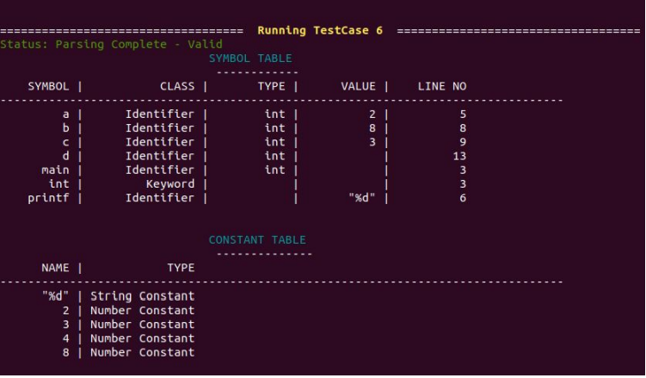
Output:

Slide 39
THANK YOU…

